Slide 1
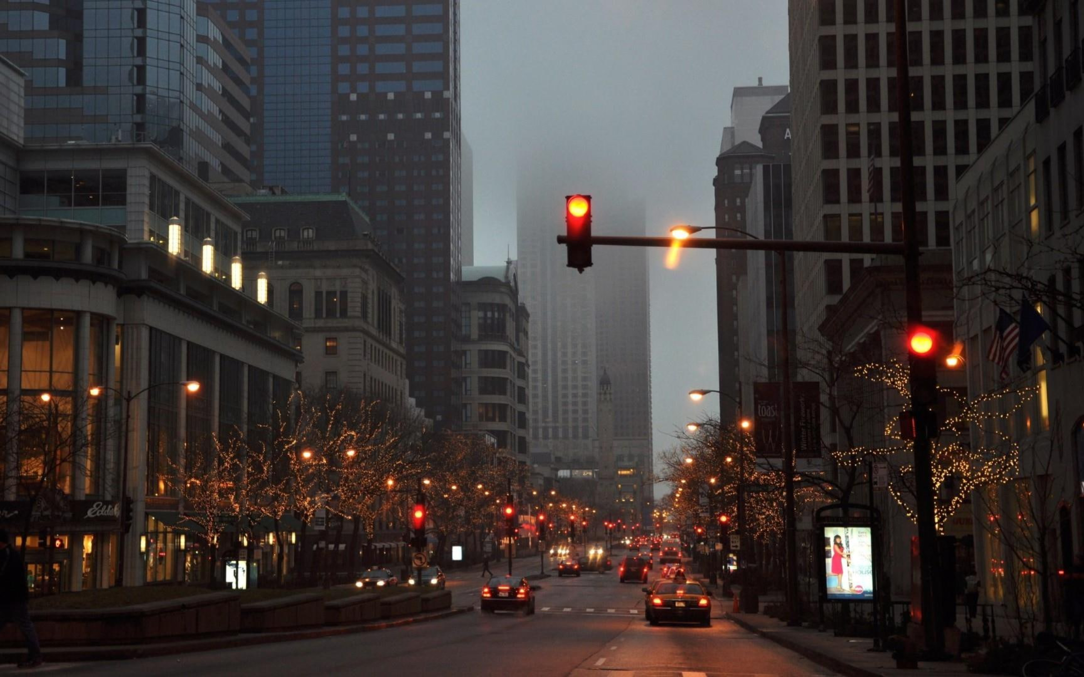
Traffic light system
Presenting By
Moshiour Rahman Prince

Slide 2
Introduction
Traffic light system
Embedded systems

Slide 3
Agenda
Implement
Coalition
Interrelation

Slide 4
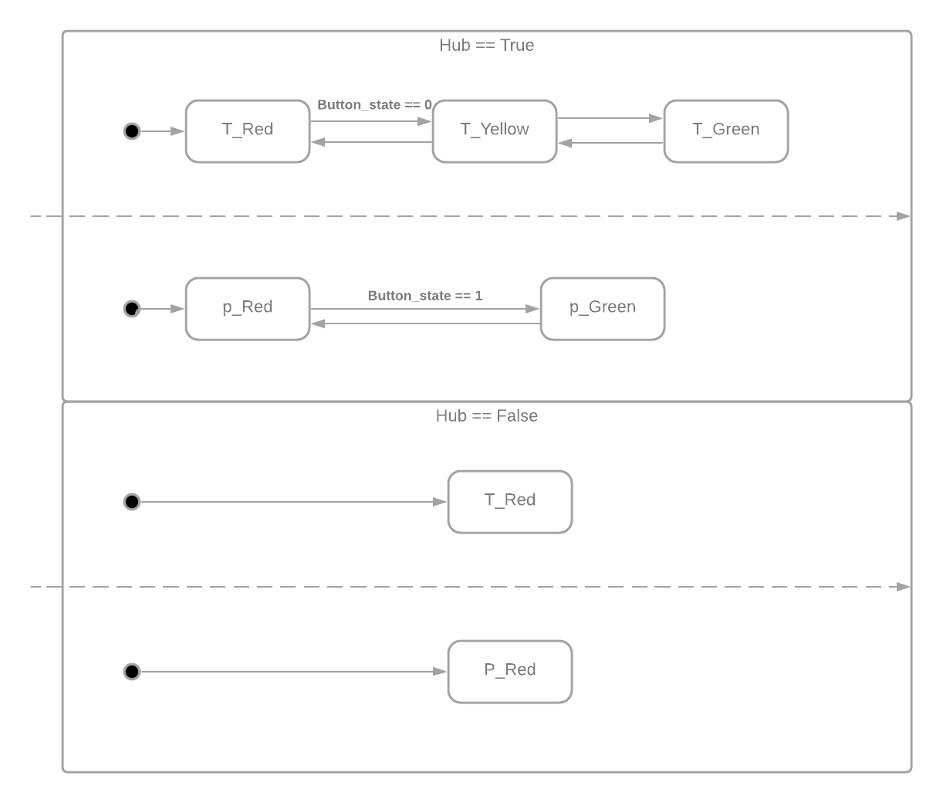
State Machine Diagram

Slide 5
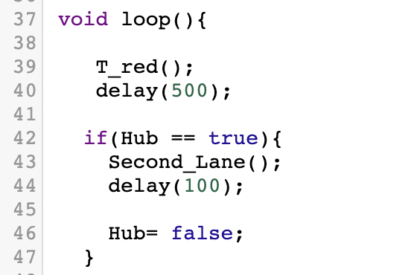
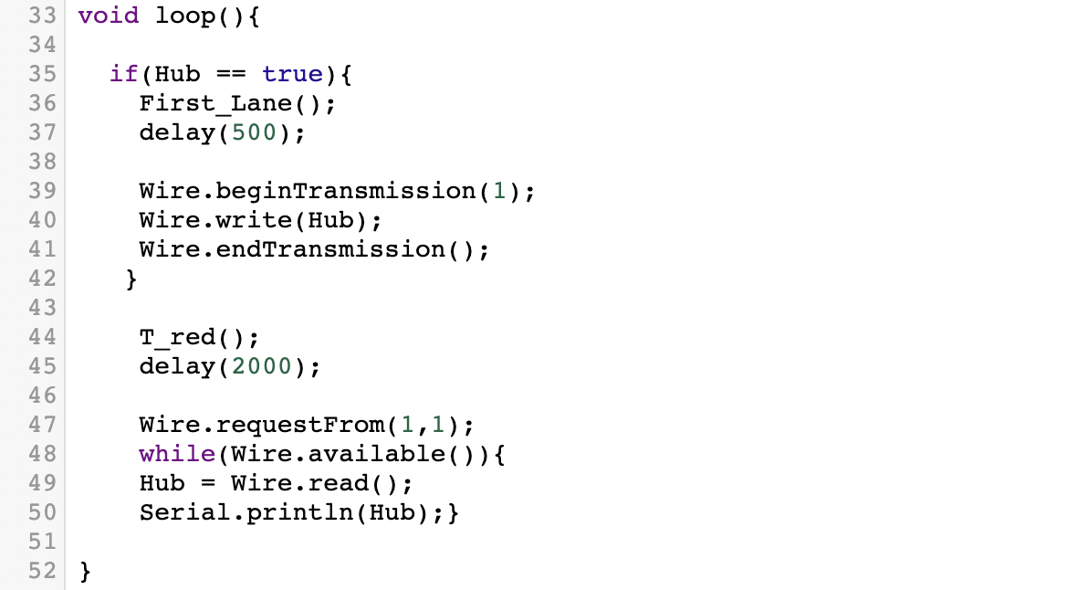
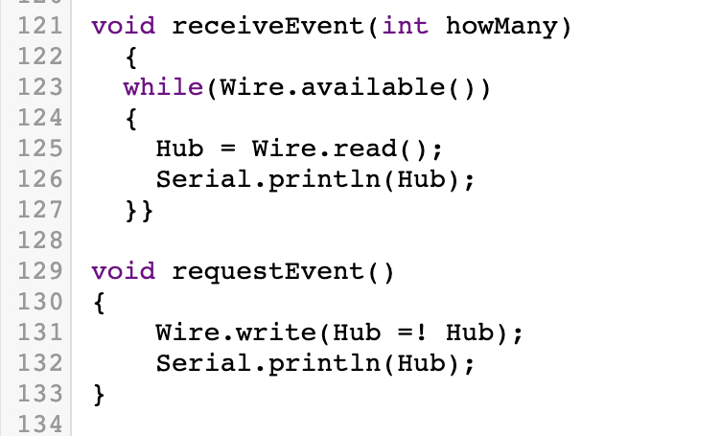
Coalition
Arduino 1
Arduino 2
Image.2.1
IImage.1.1
Image.2.2

Slide 6
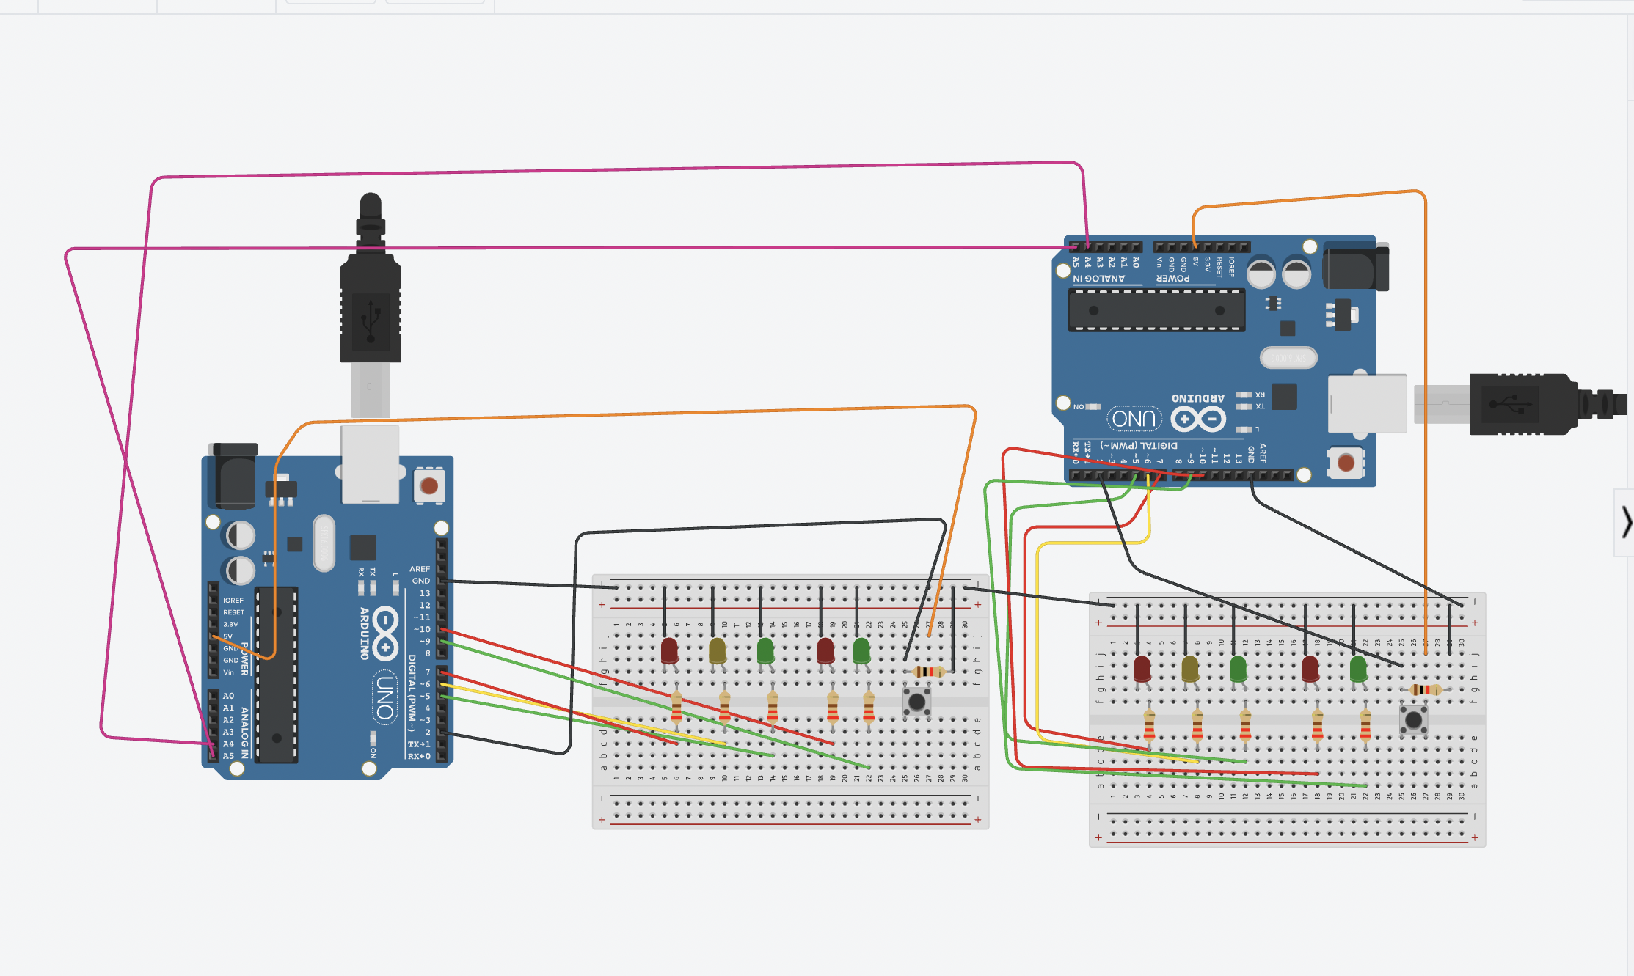
Circuit
Simulation:
https://www.tinkercad.com/things/jUg1mSZPvp6-glorious-hango/editel

Slide 7

Thank you
Do you have any question?
moshiour-rahman.prince@stud.hshl.de

